Slide 1


Demo: Running a
Cassandra cluster with Docker
EPAM BIG DATA MEETUP
Attila Szucs
attila_szucs@epam.com
JUNE 2, 2016

Slide 2
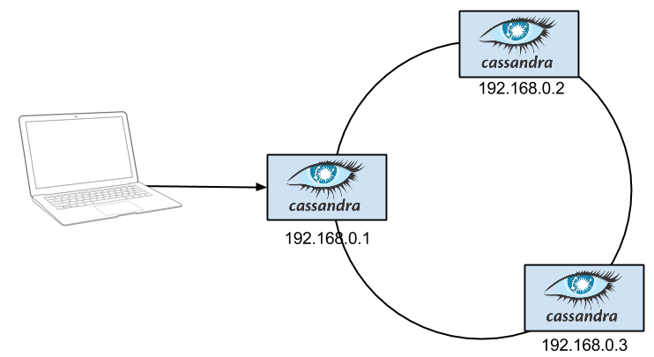
GOAL – EXPERIMENT WITH CASSANDRA
For each node:
Provision Linux machines
Install Cassandra
Configure Cassandra to form a cluster

Slide 3
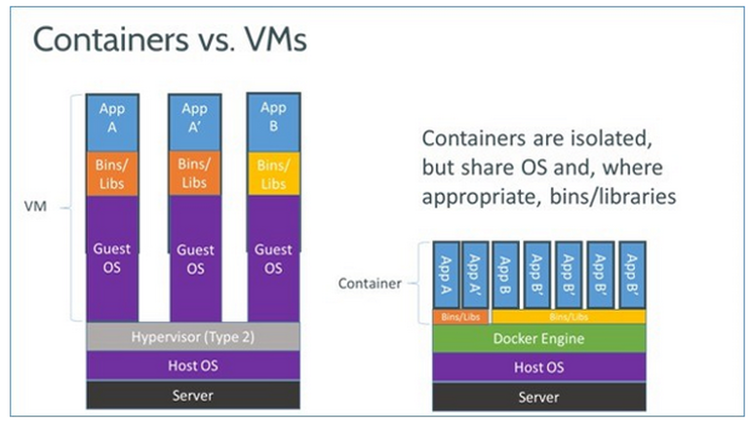
DOCKER – IN A peaNUTSHELL

Slide 4


DOCKER – BENEFITS (for us)
Incredibly fast container creation
Sub-second container creation time
No need for guest OS
Copy On Write
Rich public library of images
Similar to DEB packages, MVN repositories,
NuGet packages, NPM packages, etc…
Official images
User images (treat them with suspicion)

Slide 5

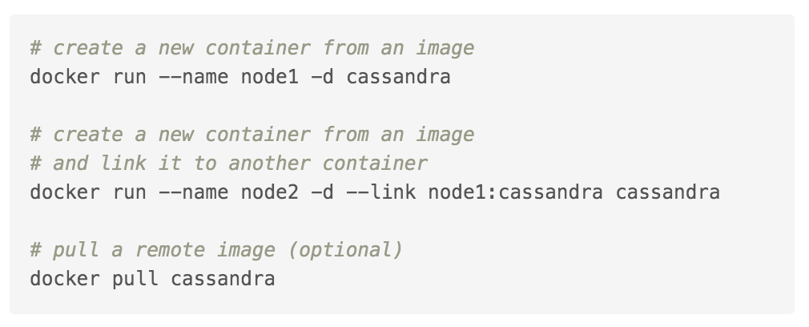
DEMO #1 – CASSANDRA OFFICIAL IMAGE
All demos are available under
http://github.com/medvekoma/docker-cassandra
Name | What is it? | Similar to…
cassandra | image | type (.class)
node1 | container | instance
Dockerfile | Docker image script file | type definition (.java)

Slide 6
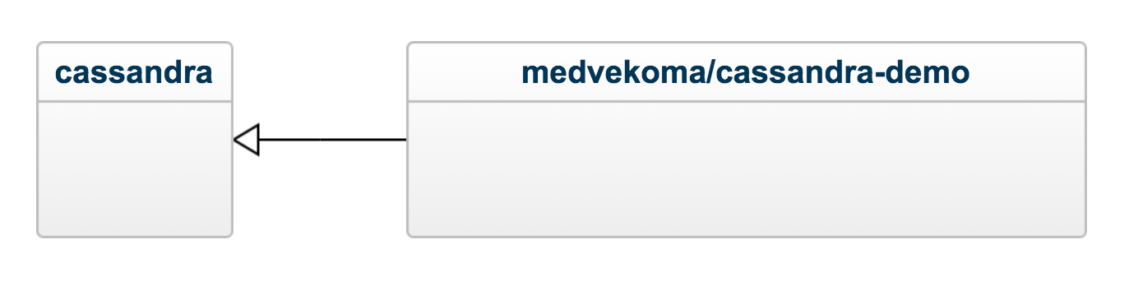
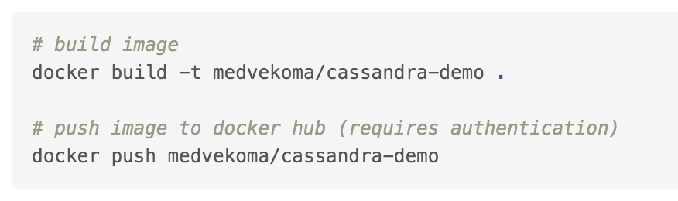
DEMO #2 – CUSTOM IMAGE
Treat images as “immutable”
Create a new image if you need new files or applications
FROM cassandra:3.3
COPY bin/* /demo/
RUN apt-get update && apt-get install -y jq

Slide 7

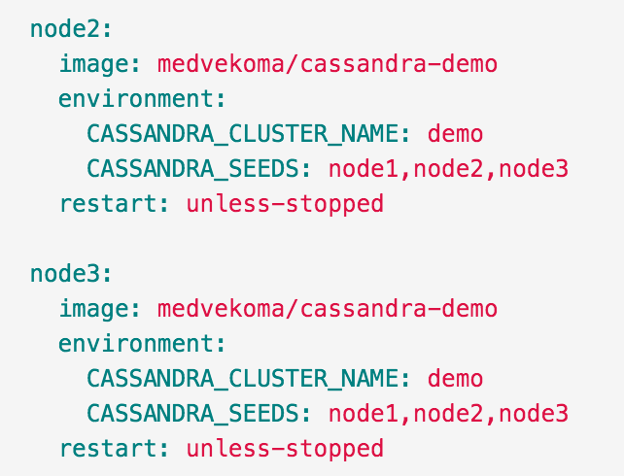
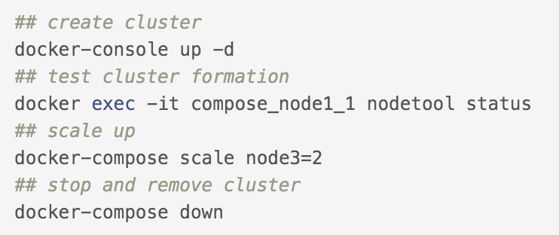
Demo #3 – Docker Compose
Still there are several steps
Let’s combine the containers

Slide 8
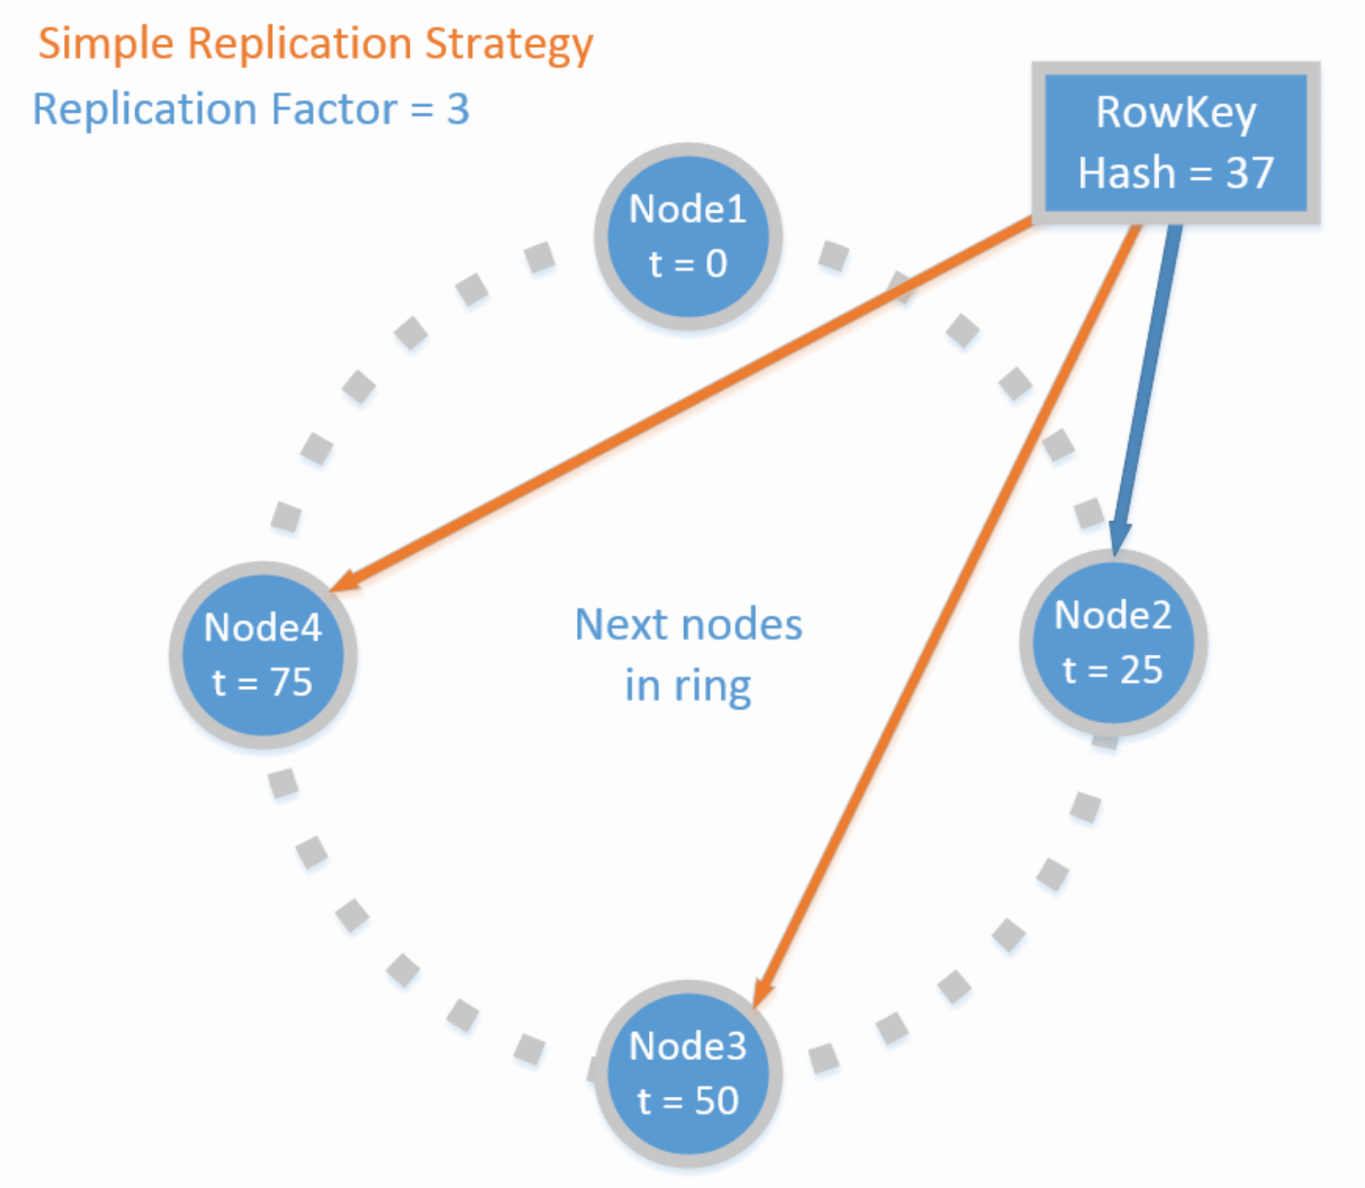
CASSANDRA DEMO #1 – CONSISTENCY

Slide 9
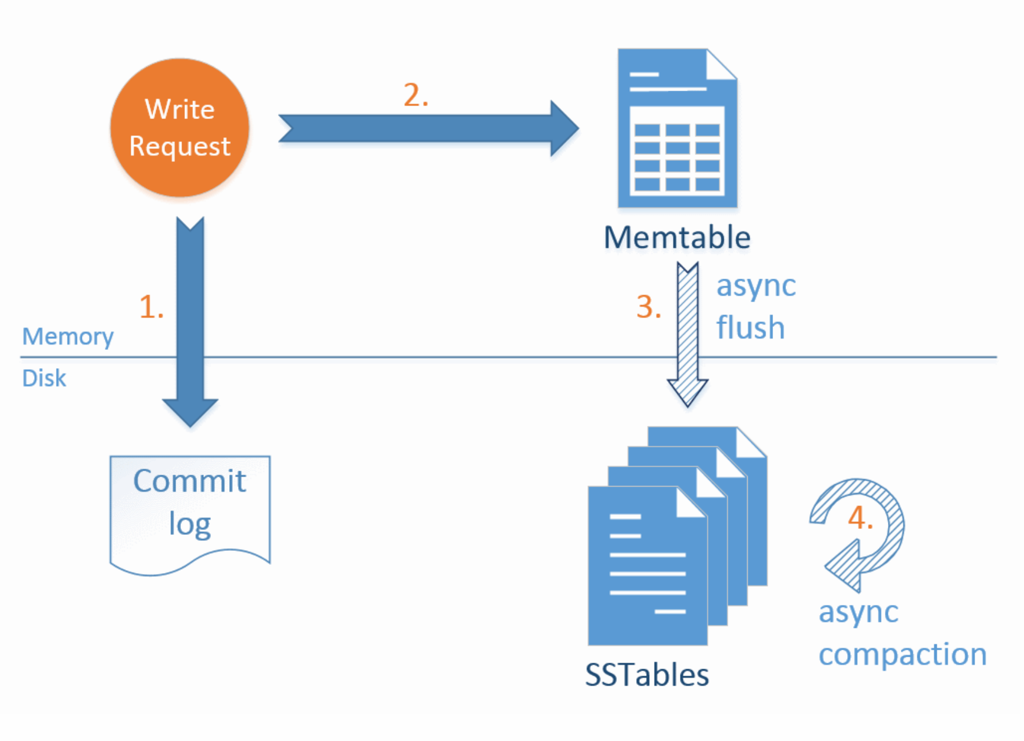
CASSANDRA DEMO #2 – WRITE PATH

Slide 10

Questions?

